Slide 1
Chapter One
Computer Security
and Privacy

Slide 2
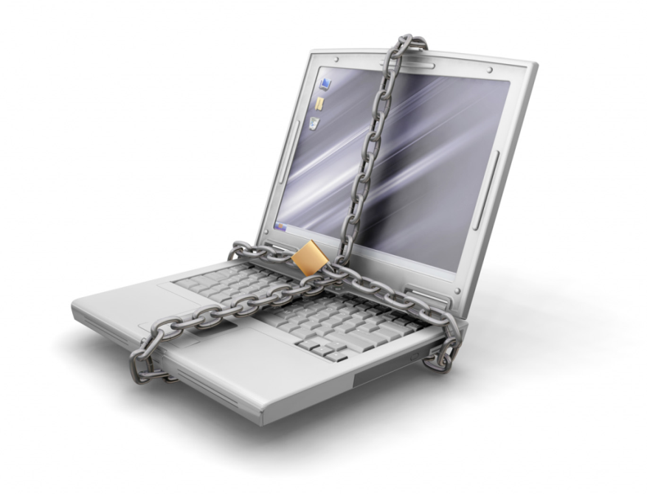



Computer Security and Privacy
“The
most secure
computers are those
not connected
to the Internet and
shielded
from any interference” air gap jumping

Slide 3
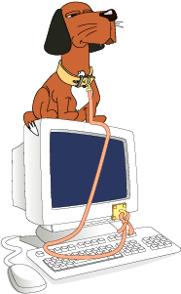
Computer Security and Privacy
Computer security is about provisions and policies adopted to protect information and property from theft, corruption, or natural disaster while allowing the information and property to remain accessible and productive to its intended users.

Slide 4
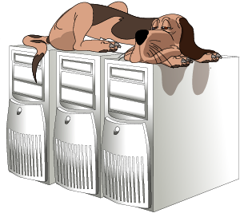
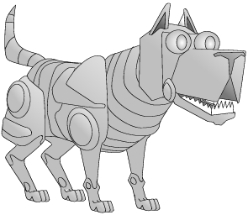
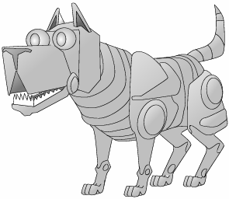
Computer Security and Privacy
Network security on the other hand deals with provisions and policies adopted to prevent and monitor unauthorized access, misuse, modification, or denial of the computer network and network-accessible resources.
Not Sufficient!!
Internet

Slide 5
Computer Security and Privacy
Security Goals: to achieve CIA
Confidentiality
Integrity
Availaibility

Slide 6
Computer Security and Privacy/ Overview
Definitions
Security: The prevention and protection of computer assets from unauthorized access, use, alteration, degradation, destruction, and other threats.
Privacy: The right of the individual to be protected against intrusion into his personal life or affairs, or those of his family, by direct physical means or by publication of information.
Security/Privacy Threat: Any person, act, or object that poses a danger to computer security/privacy.

Slide 7
Computer Security and Privacy/ History
Until 1960s computer security was limited to physical protection of computers
In the 60s and 70s
  Evolutions
    Computers became interactive
    Multiuser/Multiprogramming was invented
    More and more data started to be stored in computer databases
  Organizations and individuals started to worry about
    What the other persons using computers are doing to their data
    What is happening to their private data stored in large databases

Slide 8
Computer Security and Privacy/ History
In the 80s and 90s
  Evolutions
    Personal computers were popularized
    LANs and Internet invaded the world
    Applications such as E-commerce, E-government and
    E-health started to develop
    Viruses become majors threats
  Organizations and individuals started to worry about
    Who has access to their computers and data
    Whether they can trust a mail, a website, etc.
    Whether their privacy is protected in the connected world

Slide 9
Computer Security and Privacy/ History
Famous security problems
  Morris worm – Internet Worm
    November 2, 1988 a worm attacked more than 60,000 computers around the USA
    The worm attacks computers, and when it has installed itself, it multiplies itself, freezing the computer
    It exploited UNIX security holes in Sendmail and Finger
    A nationwide effort enabled to solve the problem within 12 hours
  Robert Morris became the first person to be indicted under the Computer Fraud and Abuse Act.
    He was sentenced to three years of probation, 400 hours of community service and a fine of $10,050
  Finally he is associate professor at the Massachusetts Institute of Technology (MIT)

Slide 10
Computer Security and Privacy/ History
Famous security problems …
  NASA shutdown
    In 1990, an Australian computer science student was charged for shutting down NASA’s computer system for 24 hours
  Airline computers
    In 1998, a major travel agency discovered that someone penetrated its ticketing system and has printed airline tickets illegally
  Bank theft
    In 1984, a bank manager was able to steal $25 million through un-audited computer transactions

Slide 11
Computer Security and Privacy/ History
Famous security problems …
In Ethiopia
  Employees of a company managed to change their salaries by fraudulently modifying the company’s database
  In 1990s Internet password theft
    Hundreds of dial-up passwords were stolen and sold to other users
    Many of the owners lost tens of thousands of Birr each
  A major company suspended the use of a remote login software by technicians who were looking at the computer of the General Manager
In Africa: Cote d’Ivoire
    An employee who has been fired by his company deleted all the data in his company’s computer

Slide 12
Computer Security and Privacy/Attacks
Categories of Attacks
Interruption: An attack on availability
Interception: An attack on confidentiality
Modification: An attack on integrity
Fabrication: An attack on authenticity

Slide 13
Computer Security and Privacy/Attacks
Categories of Attacks/Threats (W. Stallings)
Source
Destination
Normal flow of information
Attack
Interruption
Interception
Modification
Fabrication

Slide 14
Computer Security and Privacy/Vulnerabilities
Types of Vulnerabilities/ Susceptible to attack
Physical vulnerabilities (Ex. Buildings)
Natural vulnerabilities (Ex. Earthquake, fire, water…)
Hardware and Software vulnerabilities (Ex. Failures)
Media vulnerabilities (Ex. Disks can be stolen)
Communication vulnerabilities (Ex. Wires can be tapped)
Human vulnerabilities (Ex. Insiders)

Slide 15
Vulnerability Classification
Vulnerabilities are classified according to the asset class they related to:
  Hardware
    susceptibility to humidity
    susceptibility to dust
    susceptibility to soiling
    susceptibility to unprotected storage
  Software
    insufficient testing
    lack of audit trail

Slide 16
Contd.
  Network
    Unprotected communication lines
    Insecure network architecture
  Personnel
    inadequate recruiting process
    inadequate security awareness
  Site
    area subject to flood, unreliable power source
  Organizational
    lack of regular audits, lack of continuity plans

Slide 17
Computer Security and Privacy/ Countermeasures
Computer security controls
  Authentication (Password, Cards, Biometrics)
  (What we know, have, are!)
  Encryption
  Auditing
  Administrative procedures
  Standards
  Certifications
  Physical Security
  Laws

Slide 18
Computer Security and Privacy/ Physical Security
=>
Physical security is much more difficult to achieve today than some decades ago

Slide 19
Computer Security and Privacy/ Physical Security
Safe area
Safe area often is a locked place where only authorized personnel can have access
  -Are the locks reliable?
    The effectiveness of locks depends on the design, manufacture, installation and maintenance of the keys!
Surveillance with guards
  The most common in Ethiopia
  Not always the most reliable since it adds a lot of human factor
Surveillance with video
  Uses Closed Circuit Television (CCTV)

Slide 20
Why Is Computer and Network Security Important?
To protect company assets:- One of the primary goals of computer and network security is the protection of company assets (hardware, software and/or information).
To gain a competitive advantage:- Developing and maintaining effective security measures can provide an organization with a competitive advantage over its competition
To comply with regulatory requirements and fiduciary responsibilities:- organizations that rely on computers for their continuing operation must develop policies and procedures that address organizational security requirements.
    Such policies and procedures are necessary not only to protect company assets but also to protect the organization from liability
To keep your job:-Security should be part of every network or systems administrator's job. Failure to perform adequately can result in termination.

Slide 21
Vulnerabilities(Attack Surface)
  The vulnerability is not the attack, but rather exploiting the weak point/loops in order to gain access.
  Vulnerability is the intersection of three elements:
    A system susceptibility or flaw,
    attacker access to the flaw, and
    attacker capability to exploit the flaw

Slide 22
Computer Security and Privacy/ Attacks & Threats
Computer Security Attacks and Threats

Slide 23
Computer security/ Attacks & Threats
A computer security threat is any person, act, or object that poses a danger to computer security
Computer world is full of threats!
And so is the real world!
  Thieves, pick-pockets, burglars, murderers, drunk drivers, …

Slide 24
Computer security/ Attacks & Threats
Types of Threats/Attacks … (Chuck Eastom)
Hacking Attack:
  Any attempt to gain unauthorized access to your system
Physical Attack:
  Stealing, breaking or damaging of computing devices

Slide 25
Computer security/ Attacks & Threats
Types of Threats/Attacks (Chuck Eastom)
Malware Attack:
  A generic term for software that has malicious purpose
  Examples
    Viruses
    Trojan horses
    Spy-wares
    New ones: Spam/scam, identity theft, e-payment frauds, etc.

Slide 26
Computer security/Threats
Malware Attack:
Viruses
  “A small program that replicates and hides itself inside other programs usually without your knowledge.” Symantec
  Similar to biological virus: Replicates and Spreads
Worms
  An independent program that reproduces by copying itself from one computer to another
  It can do as much harm as a virus
  It often creates denial of service

Slide 27
Computer security/Threats
Malware Attack…
Trojan horses
  (Ancient Greek tale of the city of Troy and the wooden horse) - ??
  Secretly downloading a virus or some other type of mal-ware on to your computers.
Spy-wares
  “A software that literally spies on what you do on your computer.”
  Example: Simple Cookies and Key Loggers

Slide 28
Computer security/Threats
Most software based attacks are commonly called Viruses: How do viruses work?
Infection mechanisms
  First, the virus should search for and detect objects to infect
  Installation into the infectable object
    Writing on the boot sector
    Add some code to executable programs
    Add some code to initialization/auto-executable programs
    Write a macro in a word file
    …

Slide 29
Computer security/Threats
How do viruses work? …
Trigger mechanism
  Date
  Number of infections
  First use
Effects: It can be anything
    A message
    Deleting files
    Formatting disk
    Overloading processor/memory
    Etc.

Slide 30
Computer security/Threats
Anti-Virus
There are
  Generic solutions
    Ex. Integrity checking
  Virus specific solution
    Ex. Looking for known viruses
Three categories
  Scanners
  Activity monitors
  Change detection software

Slide 31
Computer security/Threats
Anti-Virus …
Functions of anti-viruses
  Identification of known viruses
  Detection of suspected viruses
  Blocking of possible viruses
  Disinfection of infected objects
  Deletion and overwriting of infected objects

Slide 32
Computer security/Threats
Hackers/Intrusion Attack:
Hacking: is any attempt to intrude or gain unauthorized access to your system either via some operating system flaw or other means. The purpose may or may not be for malicious purposes.
Cracking: is hacking conducted for malicious purposes.

Slide 33
Computer security/Threats
Denial of Service (DoS) Attack:
DoS Attack: is blocking access of legitimate users to a service.
Distributed DoS Attack: is accomplished by tricking routers into attacking a target or using Zumbie hosts to simultaneously attack a given target with large number of packets.

Slide 34
Computer security/Threats
Simple illustration of DoS attack (from Easttom)
C:\>Ping <address of X> -l 65000 –w 0 -t
Web Server X
Ping
Ping
Ping
Legitimate User
Ping

Slide 35
Computer Security and Privacy
Group Assignment
1. How security threats attack your confidential information?
2.Write short note about how these attacks work
Group-1
Spoofing Attack
Brut Force Attack
Malware Attack
Virus/Worm Attack
SMURF Attack
wanacry
Group-2
SYN Attack
Trojan Horse
Logic Bomb
Ping of Death
Packet Sniffing
Conficker
Group-3
Eavesdropping
Cracking
Session Hijacking
War Dialing
DoS/DDoS
Stexnet
Group-4
I Love You-
Code Red
Melisa
Sasser
Zeus
Mydoom
SQL injection

